Slide 1


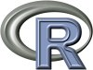


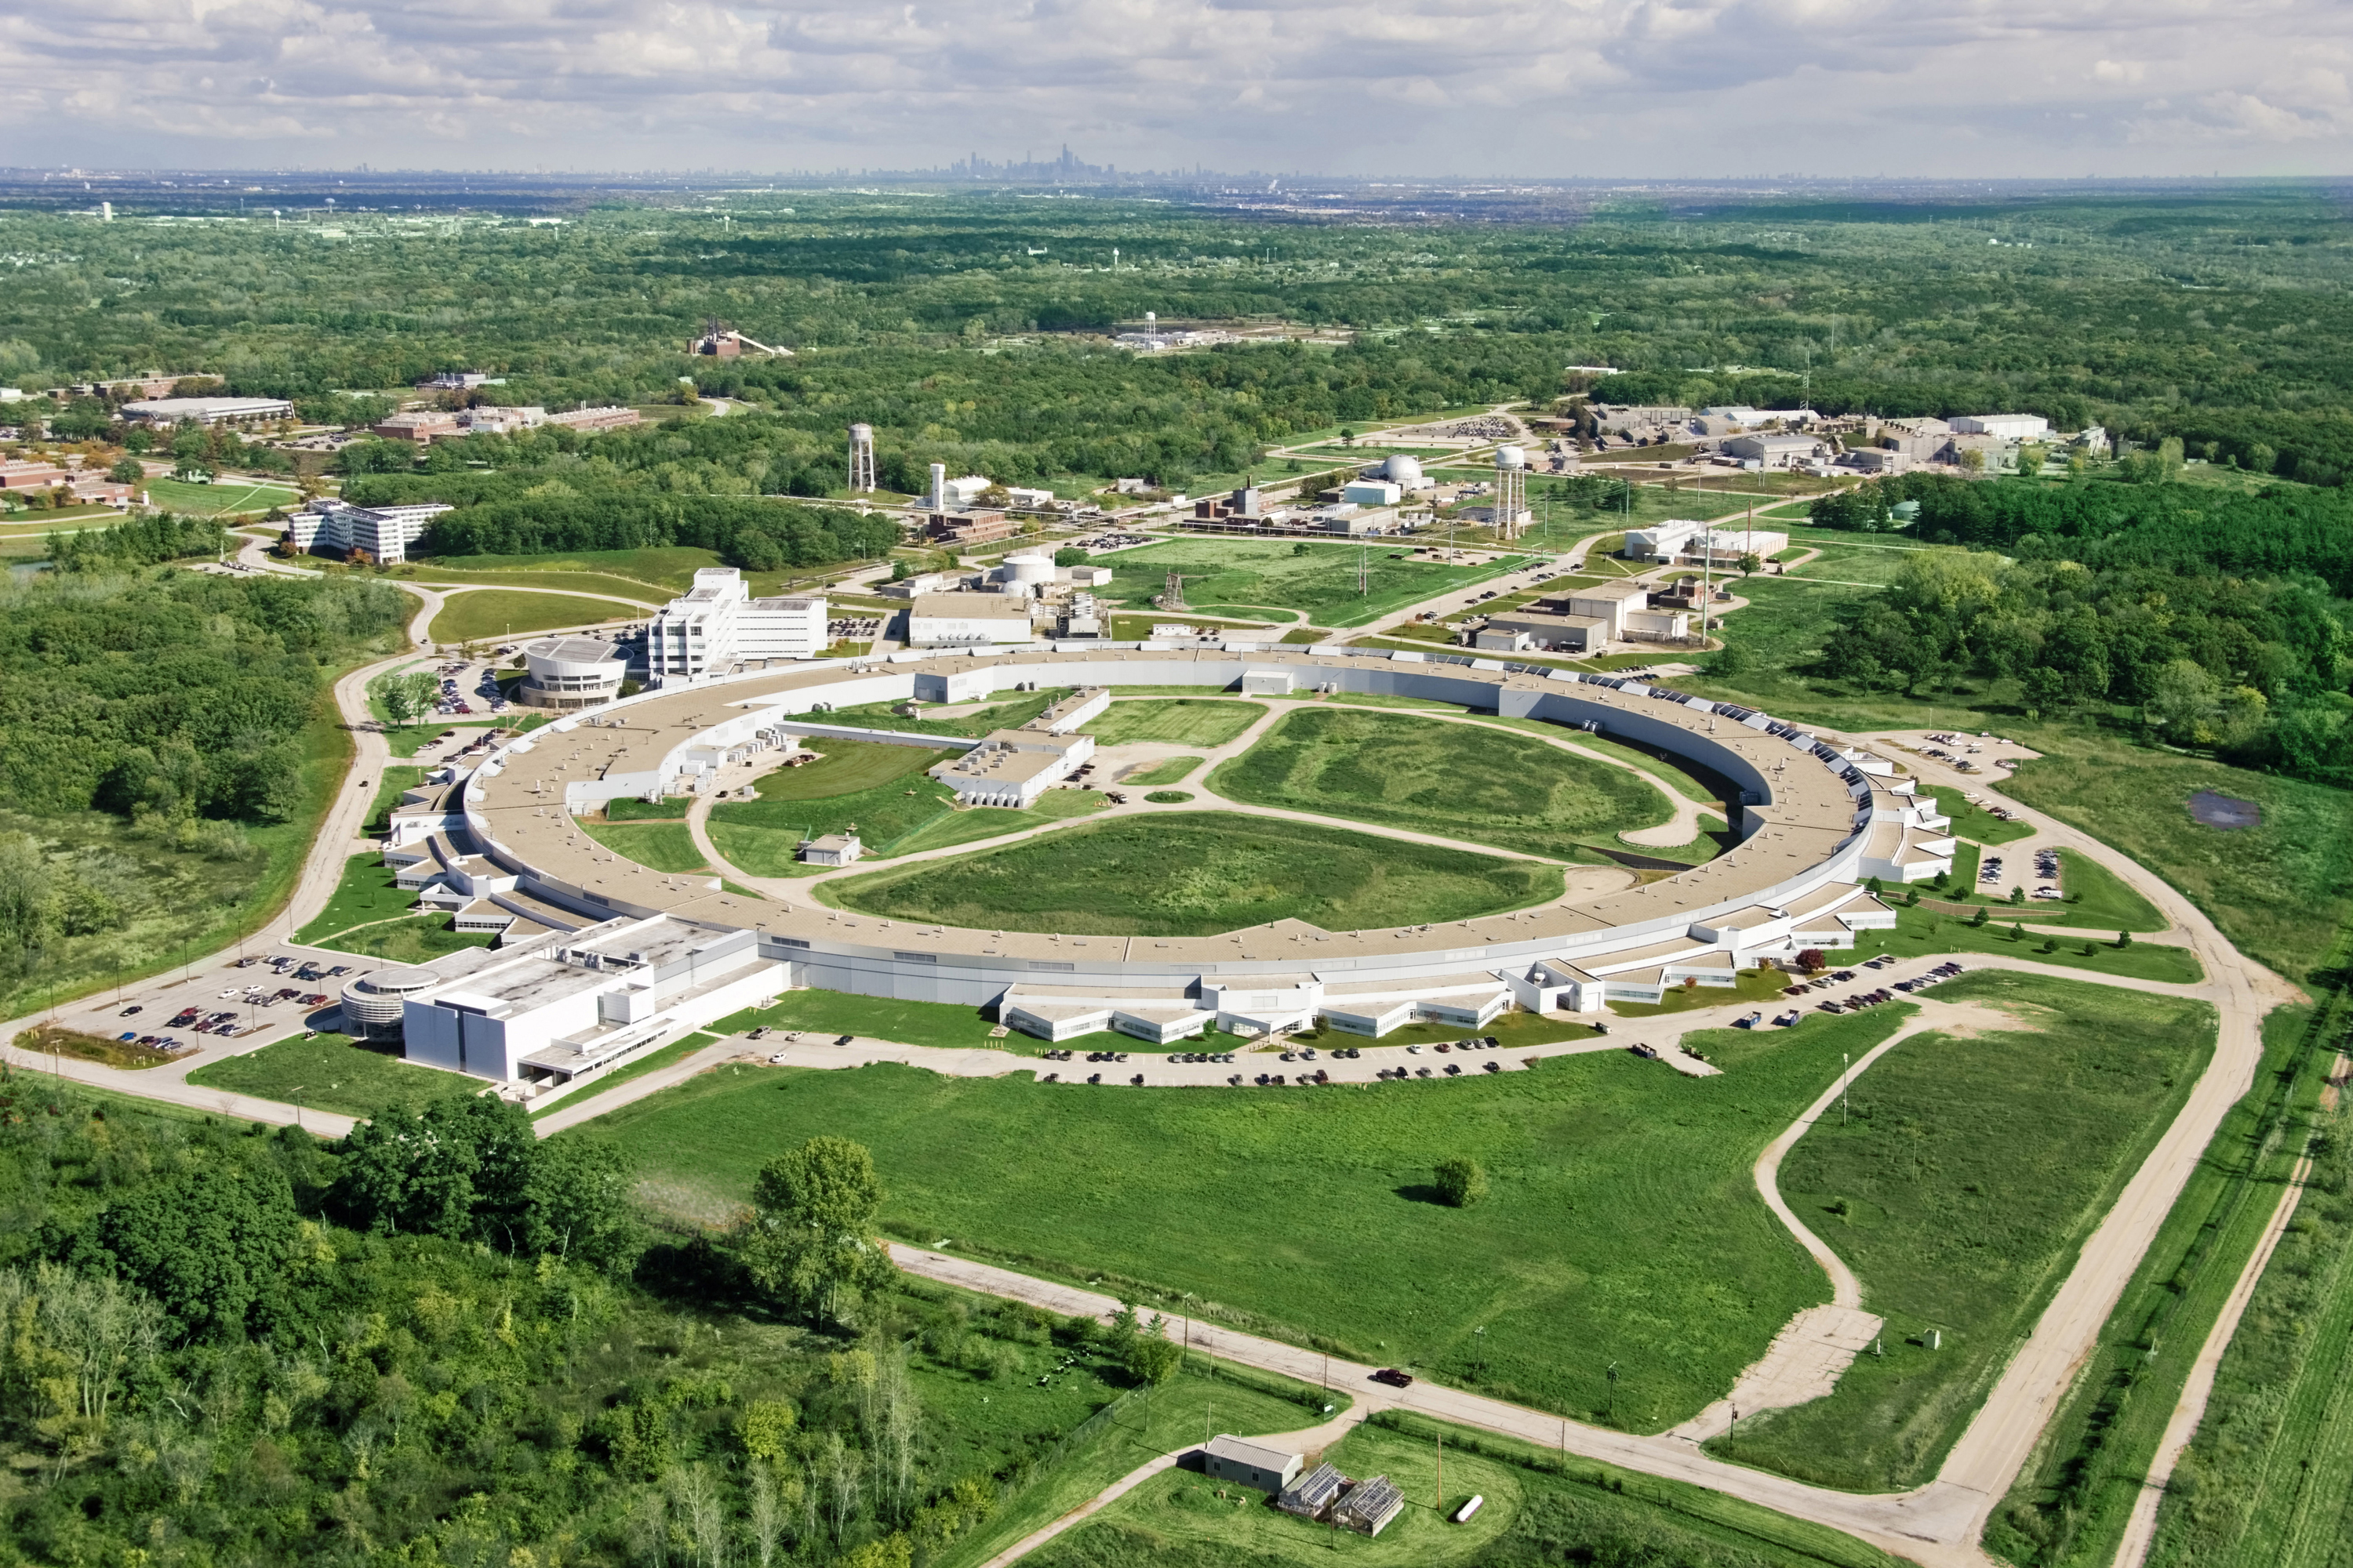
Discovery Engines: Connecting X-ray
Experiments to HPC Analysis Justin M. Wozniak¹² <wozniak@mcs.anl.gov>, Hemant Sharma¹, Michael Wilde¹², Ian T. Foster¹²
1: Argonne National Laboratory 2: University of Chicago http://sites.google.com/site/discoveryengines
Swift worker
Overview: X-ray Image Analysis
Swift: Dataflow in distributed memory
X-ray scattering is a powerful tool for the characterization of crystal structure in metals and other materials
The accelerators and detectors used by materials scientists are massive investments- however, they are rarely if ever connected to high-performance computing and storage systems. Thus, data processing is an onerous, multi-month task, which sometimes reveals only that the collected experimental data is garbage
Our work connects Argonne Photon Source detectors to the Blue Gene/Q at Argonne Leadership Computing Facility, enabling real-time visualization feedback to experimentalists on beam- no more garbage data, instant analysis results
Compositional programming: User script integrates multiple libraries into a dataflow application
Whole program runs over MPI
We provide tools to call native libraries from Swift – not just executables
Swift control process
Swift worker process
Swift control process
Swift control process
C
C++
Fortran
C
C++
Fortran
MPI
C
C++
Fortran
The data flow programming model of the Swift parallel scripting language can elegantly express the massive concurrency demanded by these applications through implicit parallelism, which has the productivity benefits of a high-level language.
Less than 1% of the MPI processes are used as control processes, which process dataflow logic, manage tasks and data
At run time, uses the Asynchronous Dynamic Load Balancer (ADLB), which was developed previously (Lusk, 2010)
Swift can utilize massive numbers of processors, distributed ~1.5 billion tasks/second (Armstrong, 2014)
Scalable run time based on ADLB
Advanced Photon Source (APS)
Key application: High Energy X-ray Diffraction Microscopy
References
J. M. Wozniak, M. Wilde, I. T. Foster. Language features for scalable distributed-memory dataflow computing. Proc. Data-Flow Models for Extreme Scale Computing at PACT 2014.
T. G. Armstrong, J. M. Wozniak, M. Wilde, I. T. Foster. Compiler techniques for massively scalable implicit task parallelism. Proc. SC 2014.
J. M. Wozniak, T. G. Armstrong, M. Wilde, D. S. Katz, E. Lusk, I. T. Foster. Swift/T: Large-scale application composition via distributed-memory data flow processing. Proc. CCGrid 2013.
J. M. Wozniak, T. G. Armstrong, K. Maheshwari, E. L. Lusk, D. S. Katz, M. Wilde, I. T. Foster. Turbine: A distributed-memory dataflow engine for high performance many-task applications. Fundamenta Informaticae 128(3), 2013.
E. L. Lusk, S. C. Pieper, and R. M. Butler. More scalability, less pain: A simple programming model and its implementation for extreme computing. SciDAC Review, 2010.
PIPS is a computationally intensive program to address problems in electrical power design and management. The original PIPS program produces potential grid management solutions. Swift is used to evaluate the solutions under varying scenarios, a naturally concurrent problem. The Swift script, which calls into PIPS libraries, was developed very quickly and scales well to 8,192 cores, the application requirement. Results from the IBM Blue Gene/P Intrepid at ANL.
Worldwide Swift usage through Nov 2012
This research is supported by the U.S. DOE Office of Science under contract DE-AC02-06CH11357, FWP-57810. Computing resources were provided by the Argonne Leadership Computing Facility.

